Slide 1
PRESENTING GAME IDEA
BY
TEAM 1

Slide 2
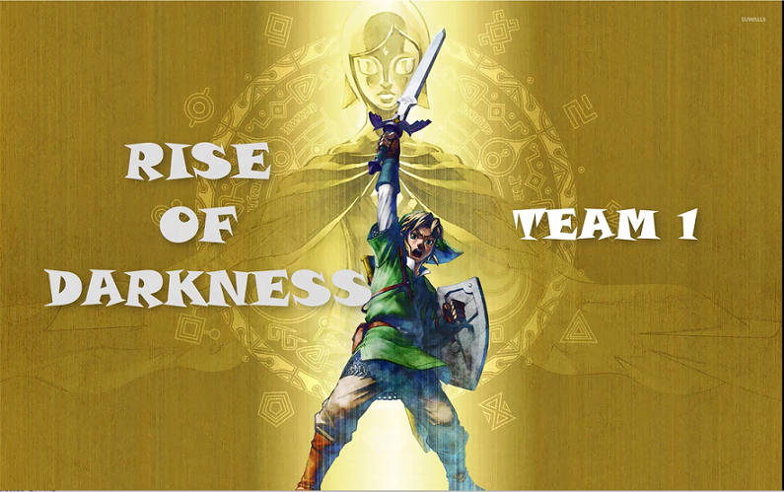

Slide 3
CONTENTS
Game summary
Game Details
Some scenes in game
How to play
Main character’s stats and other character
Inventory and Items system
Shop in game
Development plan in future

Slide 4
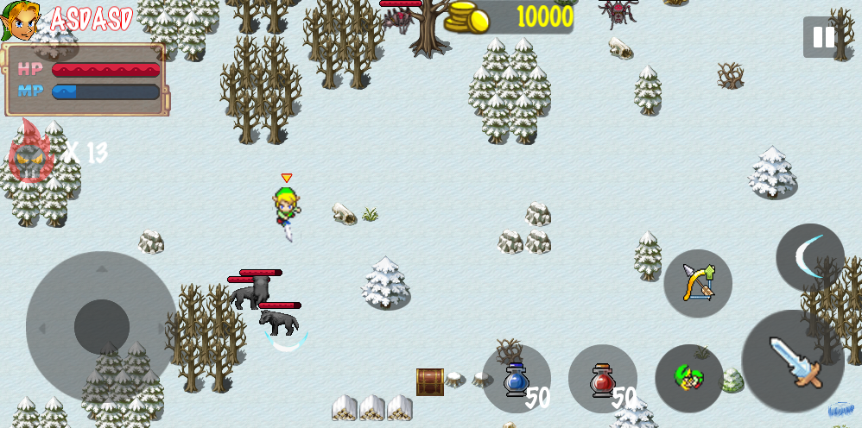
GAME SUMMARY
In summary, rise of darkness is a 2D, ¾ view, action, adventure game where you go through all various places to defeat demons army with various weapons

Slide 5

GAME DETAILS

Slide 6
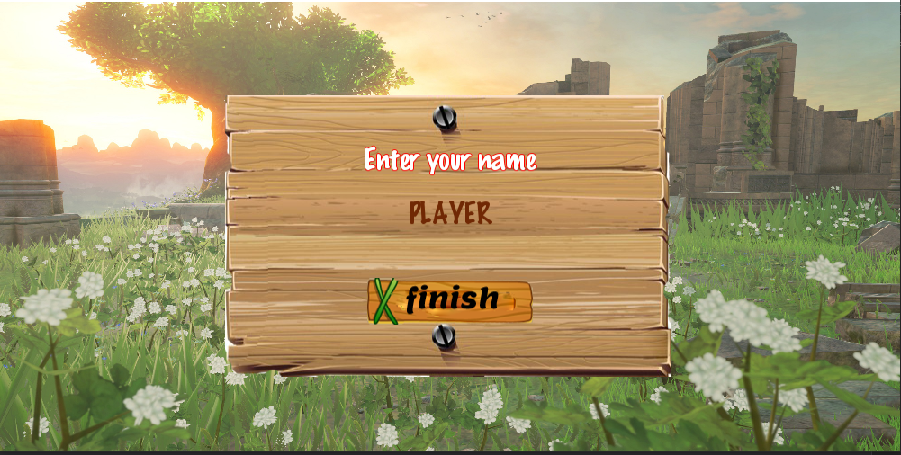
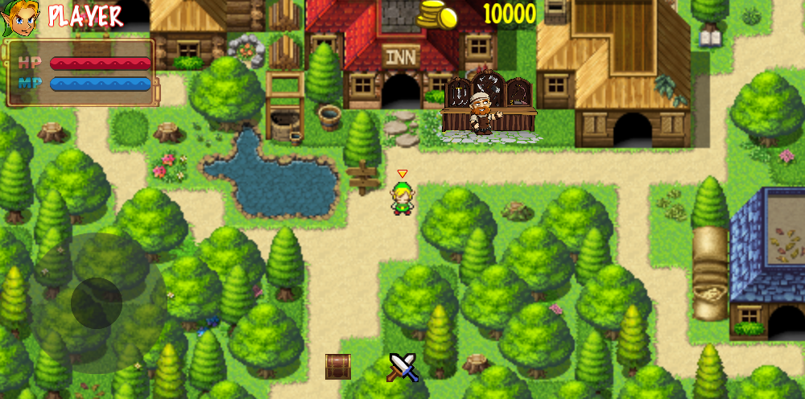
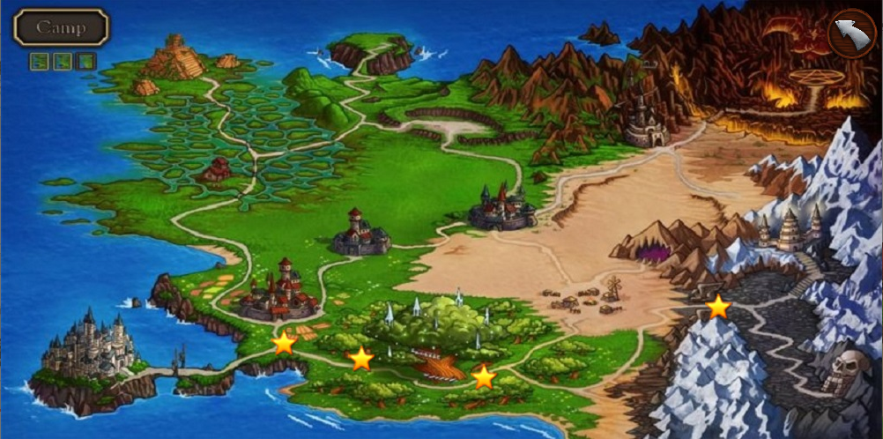
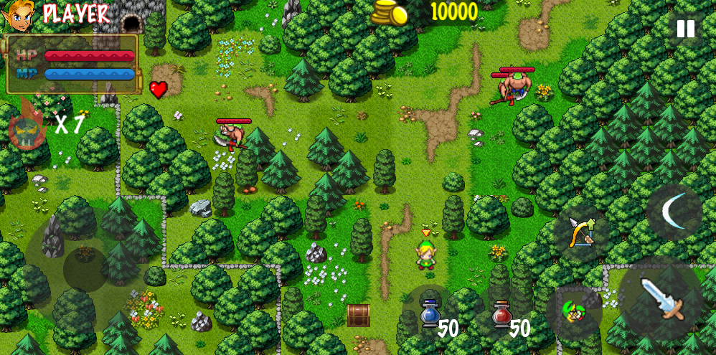
SOME SCENES IN GAME

Slide 7
HOW TO PLAY
Choose game stage

Slide 8
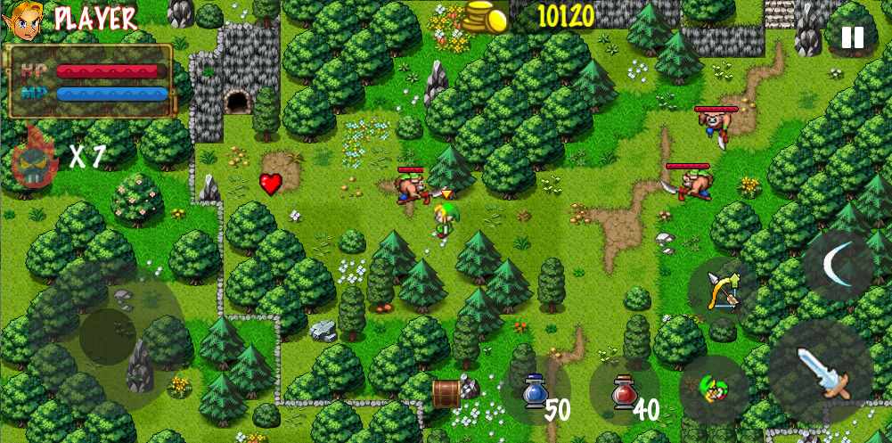
HOW TO PLAY
Defeat all monsters to clear stage

Slide 9
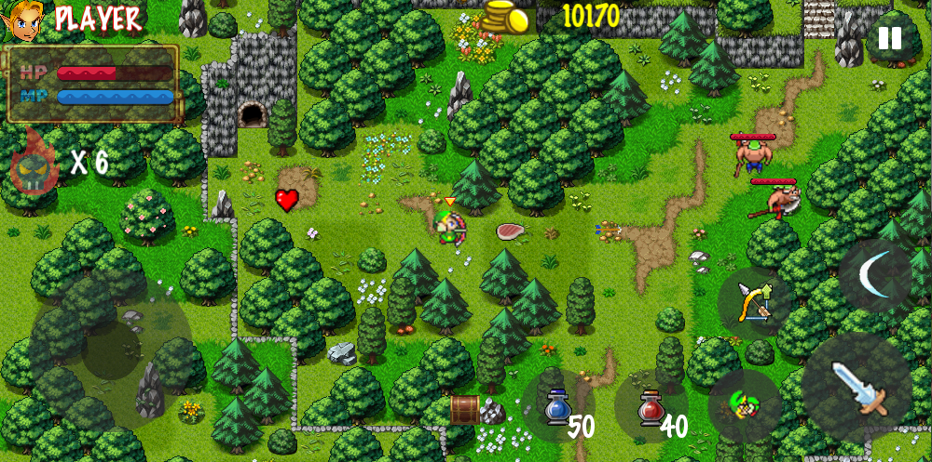
HOW TO PLAY
Earning gold and drop items when defeat monsters

Slide 10
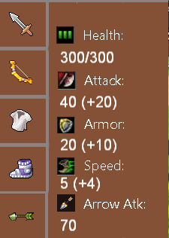

MAIN CHARACTER’S STATS
Stats board

Slide 11




MONSTERS
Health point: Higher is stronger
Attack speed: Higher is stronger
Movement speed: Higher is stronger
Attack range: Melee/Long-range
Static/Dynamic
Monster’s stats

Slide 12







MONSTERS
ENEMY’S TIER LIST
Tier 1
Nokken
Rope
Tier 2
Spear Moblin
Bow Moblin
Tier 3
Warwick
Elise
Maokai

Slide 13




























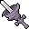


INVENTORY & ITEMS SYSTEM
Potion
Weapon
Armor
Arrow
Boots

Slide 14



INVENTORY & ITEMS SYSTEM
Heart Container item

Slide 15
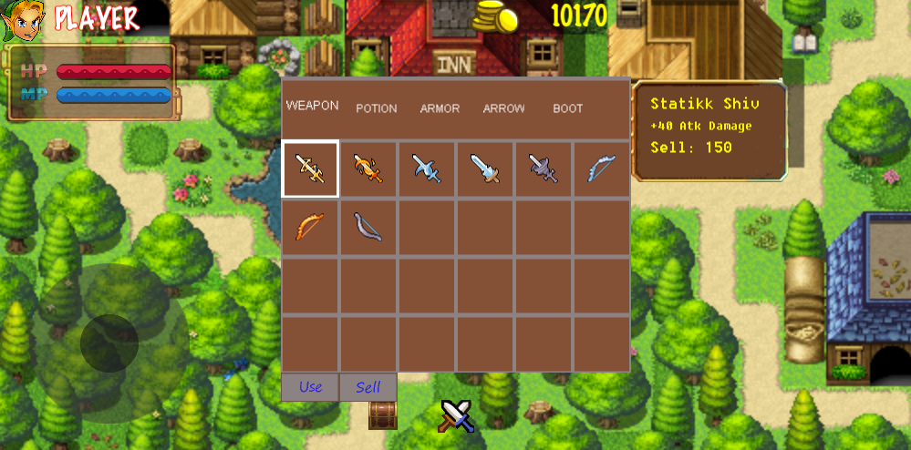
INVENTORY & ITEMS SYSTEM
Inventory

Slide 16
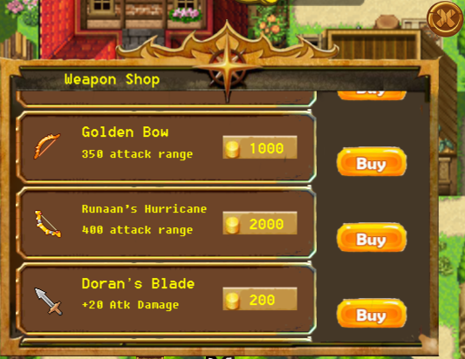
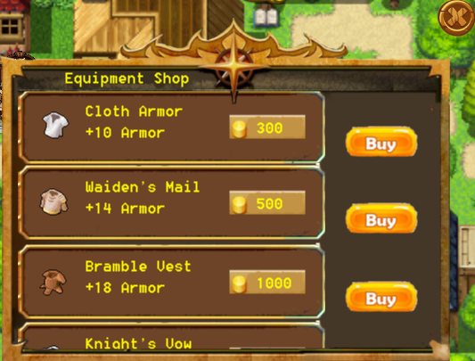
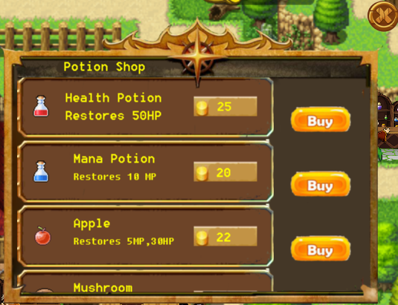
SHOP

Slide 17
DEVELOPMENT PLAN IN FUTURE
Add skills system for specific weapon.

Slide 18
THANKS!

